Slide 1



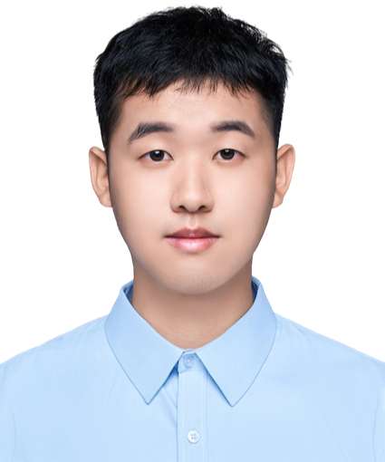

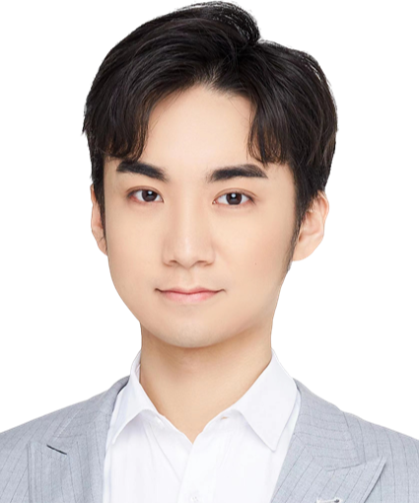
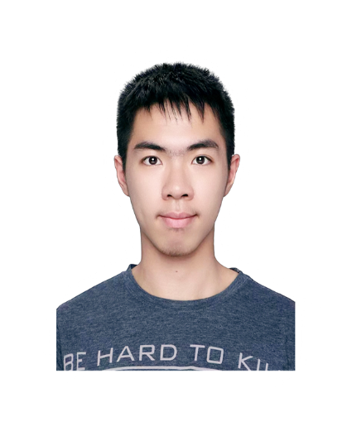


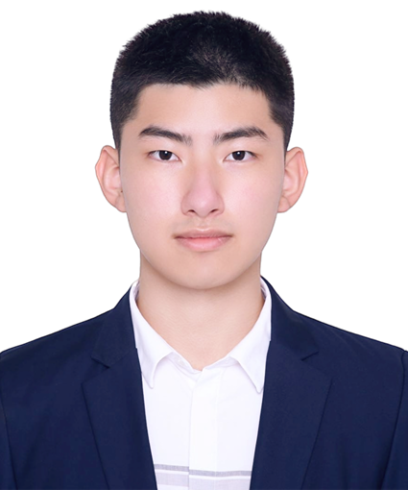

Peking University Team
Yuehao Dai
Yuxuan Wang
Major: Mathematics
Degree: PhD candidate
Hometown: Beijing
Major: Mathematics
Degree: Undergraduate
Hometown: Shanghai
Ruixiang Luo
Lintong Wu
Major: Mathematics
Degree: Undergraduate
Hometown: Chongqing
Major: Mathematics
Degree: PhD candidate
Hometown: Xiamen

